Slide 1
Experience with Hypersim on developing Digital Twins of modern power grids
Vinícius Albernaz Lacerda
Lecturer
CITCEA-UPC, Polytechnic University of Catalonia, Barcelona, Spain

Slide 2


INTRODUCTION
The energy transition is transforming the way we used to control, operate, protect, measure and simulate power systems.
Faster transients occur and reliable measurements/communications are available.
In such a fast-paced context, power grids require a substantial improvement in real-time operation and short-term planning.
Digital Twins can provide fast and accurate predictions on future grid scenarios.

Slide 3
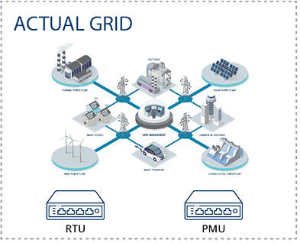
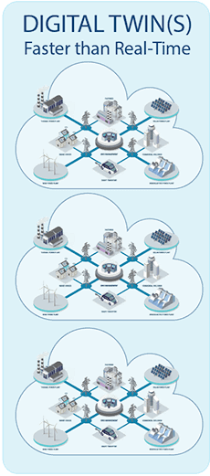
THE DIGITAL TWIN CONCEPT
A digital twin is a virtual representation of a physical system.
It allows modelling, testing and analysing possible scenarios before applying them in the real world
It can run tools to provide real-time outputs to the physical system based on anticipated behaviour informed by the digital twin.
Tool 1
Actions
Inter-tool communication
Tool 2
Measurements
Tool n
Source: adapted from https://www.opal-rt.com/digital-twins/

Slide 4
THE HP2C-DT PROJECT - TOOLS
The HP2C-DT project (High-Precision High-Performance Computer-enabled Digital Twins for modern power system applications) aims to investigate the benefits of Digital Twins of power grids.
Large power grids are simulated using High-Performance Computing.
Supercomputer
Online Stability
Actions
Optimal Operation
Real-time equivalents
Measurements
Adaptive protection
Source: adapted from https://www.opal-rt.com/digital-twins/

Slide 5

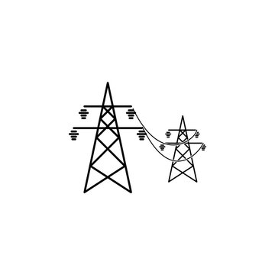
THE HP2C-DT PROJECT
Weather/Forecast
Real-time data
Signals exchanged
D – Probabilistic Scenario
Available generation
Restrictions
B1 – Optimal Operation
Optimal Power Flow
A1 – Online Stability
B2 – Network Equivalents
Grid Status
Real time Power Flow
Short-Circuit Level
A2 – Online Interaction
E – Automatic Operation and Control
Grid Status
C – Adaptative Protection
Actions
Relays Coordination
Send
Receive
Real Grid

Slide 6


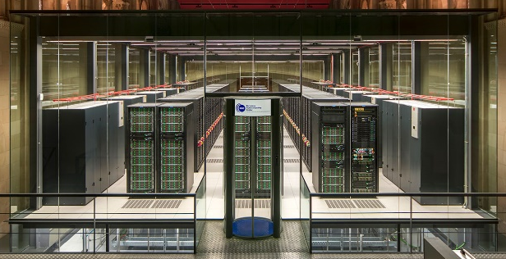
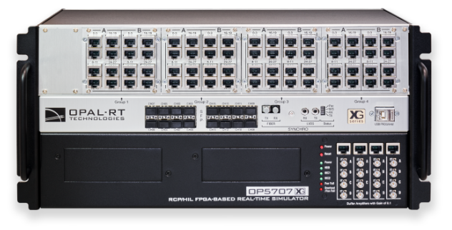
COMMUNICATION
Database
Data
User inputs
Server
Calculations
Visualization
Results
User interface
Input actions
Real-time data
Marenostrum supercomputer
Edge Devices
Quick processing
Input actions
Ethernet
Real-time data
OPAL-RT/Hypersim

Slide 7
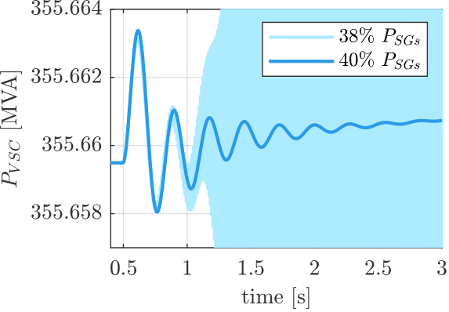
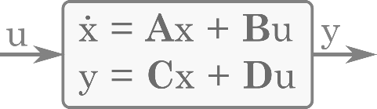
SMALL-SIGNAL ANALYSIS TOOL
Examines stability under small disturbances
Characterize frequency and damping of oscillations
Identify interactions between network components
Relies on the State-Space model of the grid
Linearization of EMT differential equations around an operating point
Modelling time may be unaffordable for large-scale systems
Automatized modelling and analysis tools are required
Pole map
Time-domain linear simulation
Participation factor analysis
State-Space Representation

Slide 8

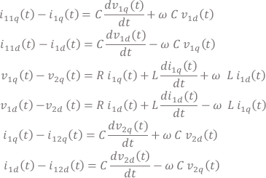
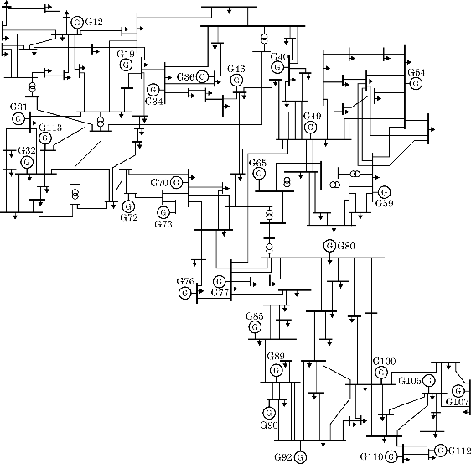
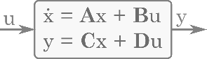

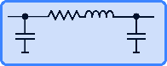



SMALL-SIGNAL ANALYSIS TOOL
The small-signal analysis tool integrated in the DT is based on a modular approach which facilitates the modelling of large-scale power systems.
Linearization
State-Space Model
Traditional approach
etc.
Modular approach
177 lines
9 transformers
91 loads
28 generator units
IEEE 118-bus system
State-Space models library
State-Space Model

Slide 9
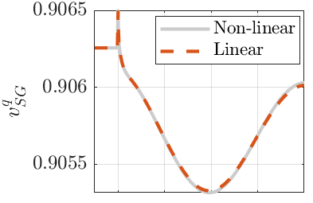

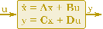
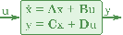
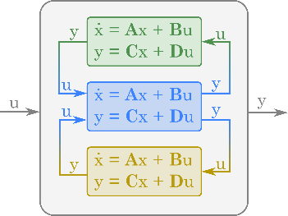

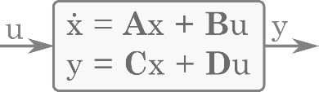
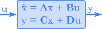
SMALL-SIGNAL ANALYSIS TOOL
Hypersim
The workflow
Validation against non-linear EMT simulation
The tool is implemented in Python
Libraries: GridCal, Python Control Systems Library
Grid topology
Excel
GridCal
Operating
point
.raw (PSS/E)
State-Space model
System data main file
Power-flow calculation
State-Space blocks generation
State-Space blocks interconnection
Control parameters
Excel
Python Control Systems Library
Small-signal analysis
Small-signal analysis tool
Data input

Slide 10
SMALL-SIGNAL ANALYSIS TOOL
Hypersim
The workflow
Validation against non-linear EMT simulation
The tool is implemented in Python
Libraries: GridCal, Python Control Systems Library
Grid topology
Excel
GridCal
Operating
point
.raw (PSS/E)
State-Space model
System data main file
Power flow calculation
State-Space blocks generation
State-Space blocks interconnection
Control parameters
Excel
Python Control Systems Library
Small-signal analysis
Small-signal analysis tool
Data input

Slide 11

Sampled Input Data
Operating
point
Control parameters
Python DataFrame
Python DataFrame
Power flow calculation
State-Space blocks generation
GridCal
Python Control
Systems Library
Constant Input Data
Grid topology
Control parameters
.raw (PSS/E)
Excel
Small-signal analysis
ξ
Equilibrium
point
State-Space model
G(s)
H₂ norm
DC Gains
Power flow calculation
State-Space blocks generation
State-Space blocks interconnection
GridCal
Python Control Systems Library
Operating
point
Control parameters
Sampled Input Data
Python DataFrame
Python DataFrame

Slide 12
Space Definition
1° Space Partition
Exploration

Slide 13


Space Definition
Sampled Input Data
Case Study: 118 Bus System
Operating
point
Control parameters
System elements:
28 Generation buses
91 Loads buses
172 Lines
9 Transformers
Python DataFrame
Python DataFrame
P,Q @Load Bus
P,V @Generation Bus
V,θ @Slack Bus
Power flow calculation
GridCal
Define a system set-up
Amount of power installed in each Generation Bus
Peak and minimum total power demand
Loads’ participation factors

Slide 14
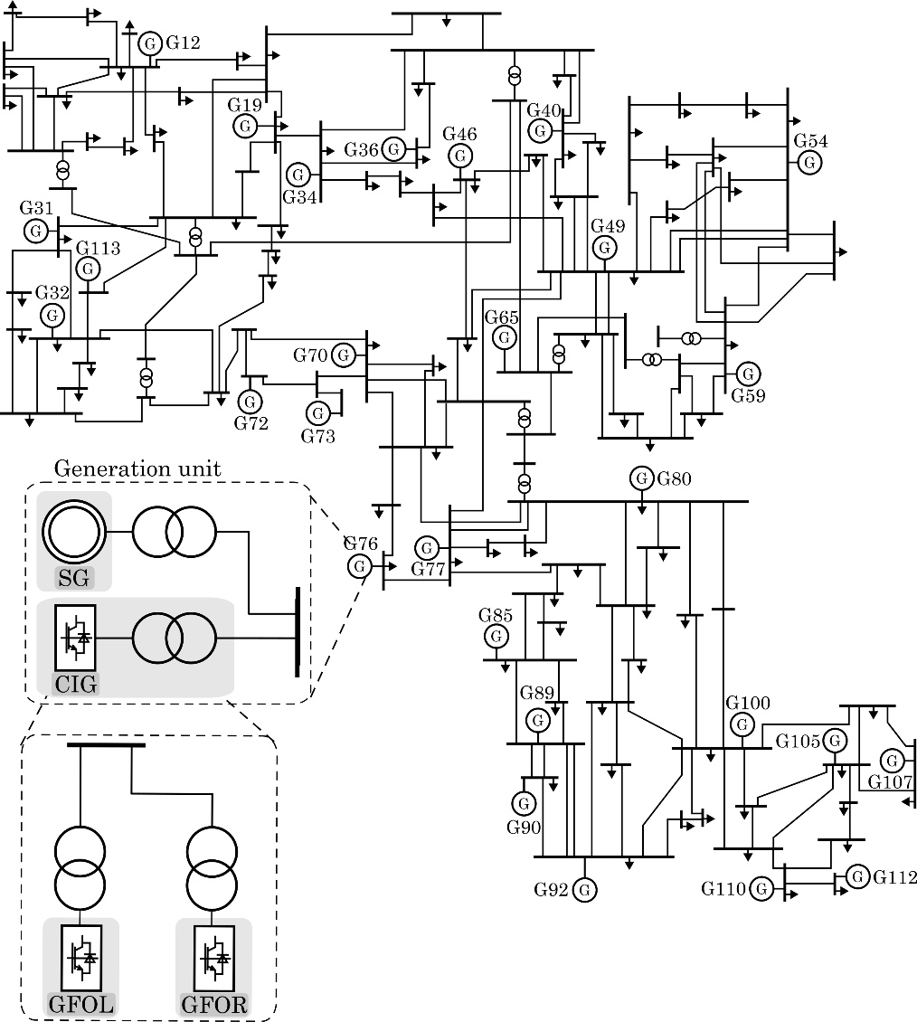
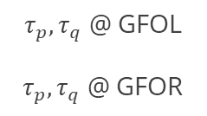
Space Definition
Sampled Input Data
Case Study: 118 Bus System
Operating
point
Control parameters
System elements:
28 Generation buses
91 Loads buses
172 Lines
9 Transformers
Python DataFrame
Python DataFrame
P,Q @SG
P,Q @ GFOL
P,Q @ GFOR
$τ_{p},τ_{q}$ @ GFOL
$τ_{p},τ_{q}$ @ GFOR
State-Space blocks generation
Python Control
Systems Library

Slide 15
Space Definition
Case Study: 118 Bus System
Dimensions
of the space
Variables for
each dimension
In each Generation bus, define:
The SG installed power
The CIG installed power
Define a system set-up:
Amount of power installed in each Generation Bus
Peak and minimum total power demand
Loads’ participation factors
System elements:
28 Generation buses
91 Loads buses
172 Lines
9 Transformers

Slide 16
Variables associated to each non-independent dimension | Not-independent Dimensions |  | Dimensions of the space | Variables associated to each dimension |  | Not-indipendent variables
Power absorbed by each load | Total power demand |  | Total power injected by SGs | Power injected by each SG
 |  |  | Total power injected by CIGs | Power injected by each CIG |  | Power injected by each GFOL-CIG
 |  |  | Total power injected by GFOR-CIGs | Power injected by each GFOR-CIG
 |  |  |  | Voltage at each generation bus
 |  |  |  |  | Power Flow calculation | Reactive Power at each generation bus → proportionally shared among SG, GFOR, GFOL
 |  |  | tau_p of each GFOR-CIG
 |  |  | tau_q of each GFOR-CIG
 |  |  | tau_p of each GFOL-CIG
 |  |  | tau_q of each GFOL-CIG
Space Definition
+
+
+
-
Dimensions
of the space
Variables for
each dimension
Total power injected by SGs
Total power injected by CIGs
Total power injected by GFOR-CIGs
-
Power injected by each SG
Power injected by each CIG
Power injected by each GFOR-CIG
Power injected by each GFOL-CIG

Slide 17
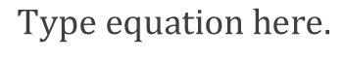
Variables associated to each non-independent dimension | Not-independent Dimensions |  | Dimensions of the space | Limits | Variables associated to each dimension |  | Not-indipendent variables
Power absorbed by each load | Total power demand |  | Total power injected by SGs |  | Power injected by each SG
 |  |  | Total power injected by CIGs |  | Power injected by each CIG |  | Power injected by each GFOL-CIG
 |  |  | Total power injected by GFOR-CIGs |  | Power injected by each GFOR-CIG
 |  |  | Voltage at each generation bus
 |  |  |  |  |  | Power Flow calculation | Reactive Power at each generation bus → proportionally shared among SG, GFOR, GFOL
 |  |  | tau_p of each GFOR-CIG
 |  |  | tau_q of each GFOR-CIG
 |  |  | tau_p of each GFOL-CIG
 |  |  | tau_q of each GFOL-CIG
Space Definition
Dimensions
of the space
Variables for
each dimension
Total power injected by SGs
Total power injected by CIGs
Total power injected by GFOR-CIGs
-
Power injected by each SG
Power injected by each CIG
Power injected by each GFOR-CIG
Power injected by each GFOL-CIG

Slide 18
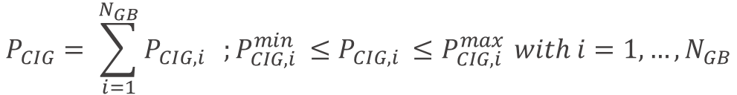
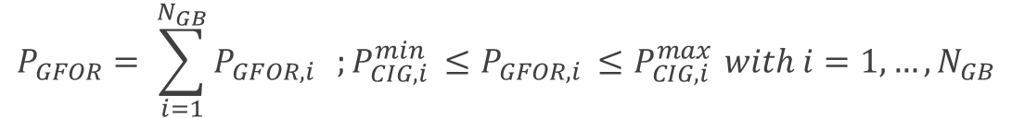
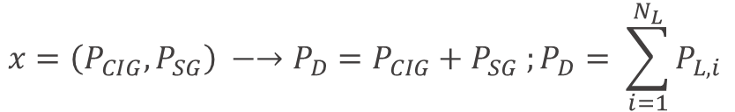
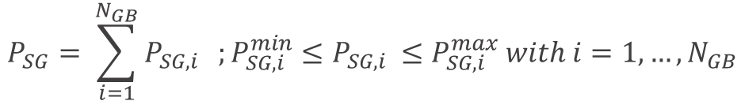
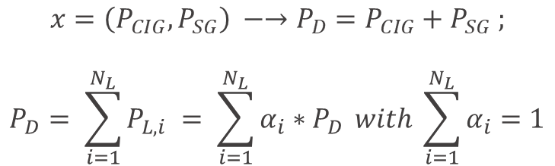
$$x=\left(P_{CIG},P_{SG}\right) −→P_{D}=P_{CIG}+P_{SG} ;$$
$$P_{D}= \sum_{i=1}^{N_{L}}{P_{L,i} }= \sum_{i=1}^{N_{L}}{α_{i}∗P_{D}} with \sum_{i=1}^{N_{L}}{α_{i}=1}$$
Space Definition
$$x=\left(P_{CIG},P_{SG}\right) −→P_{D}=P_{CIG}+P_{SG} ;P_{D}= \sum_{i=1}^{N_{L}}{P_{L,i }}$$
$$V_{i}^{min}{≤ V}_{i}≤V_{i}^{max} with i=1,…, N_{GB}$$
$$P_{SG}= \sum_{i=1}^{N_{GB}}{P_{SG,i}} ;P_{SG,i }^{min}≤P_{SG,i }≤P_{SG,i }^{max} with i=1,…,N_{GB}$$
$$P_{CIG}= \sum_{i=1}^{N_{GB}}{P_{CIG,i}} ;P_{CIG,i }^{min}≤P_{CIG,i }≤P_{CIG,i }^{max} with i=1,…,N_{GB}$$
$$P_{GFOR}= \sum_{i=1}^{N_{GB}}{P_{GFOR,i}} ;P_{CIG,i }^{min}≤P_{GFOR,i }≤P_{CIG,i }^{max} with i=1,…,N_{GB}$$
$$P_{GFOL,i}=P_{CIG,i} −P_{GFOR,i} with i=1,…, N_{GB}$$
Dimensions
of the space
Variables for
each dimension
Total power injected by SGs
Total power injected by CIGs
Total power injected by GFOR-CIGs
-
Power injected by each SG
Power injected by each CIG
Power injected by each GFOR-CIG
Power injected by each GFOL-CIG

Slide 19



SMALL-SIGNAL ANALYSIS TOOL
The application
Update operating point
Update grid topology
Power-flow data
State of breakers
Small-signal analysis tool
Rebuild State-space model
DT
OPAL-RT
Control actions
Perform small-signal analysis
¿Stability?
¿Interactions?

Slide 20
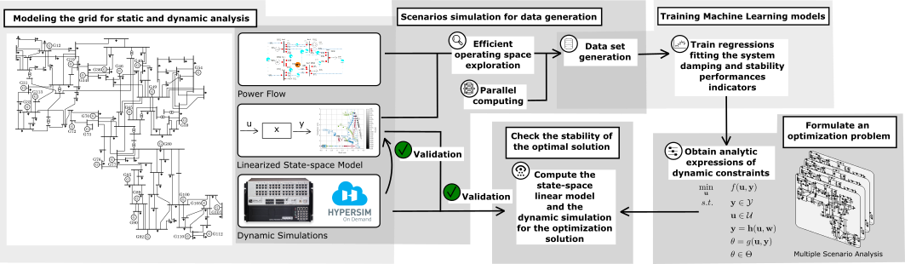
DT TOOL: Small-signal Stability Constrained Optimal Power Flow
OPF with dynamic constraint, formulated as a data-driven surrogate model of conventional small-signal analysis.
Data-driven surrogate model: regression function fitting the system damping as a function of the quantities describing the operating conditions.
Training data: obtained by computation.

Slide 21
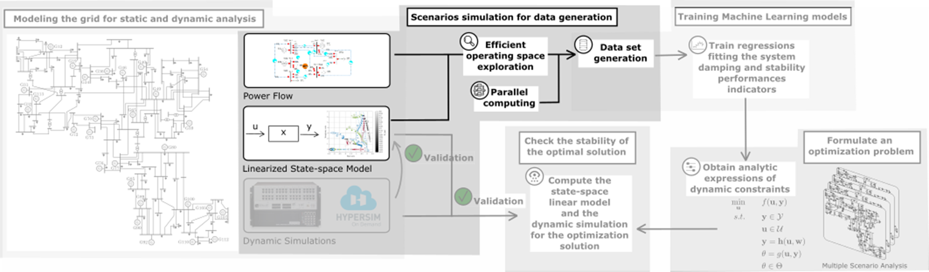
DT Tool: Small-signal Stability Constrained Optimal Power Flow
OPF with dynamic constraint, formulated as a data-driven surrogate model of conventional small-signal analysis
Data-driven surrogate model: regression function fitting the system damping as a function of the quantities describing the operating conditions
Training data: obtained by computation

Slide 22
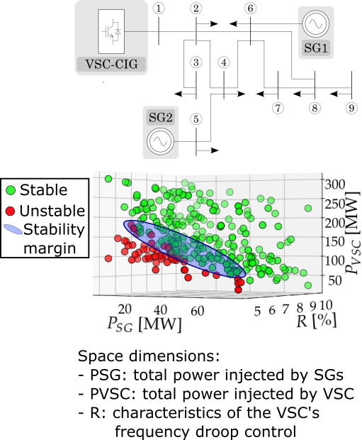
DATA GENERATION
Create a high-information content data set avoiding curse-of-dimensionality:
Explore the entire operating space of the system (different operating points, different converters’ control modes, etc.)
Select a limited number of significative samples, by the Latin Hypercube Sampling strategy
Orient sampling towards the stability margin of the system, by the use of the Entropy function
→ Sequential algorithm for efficient data set generation

Slide 23
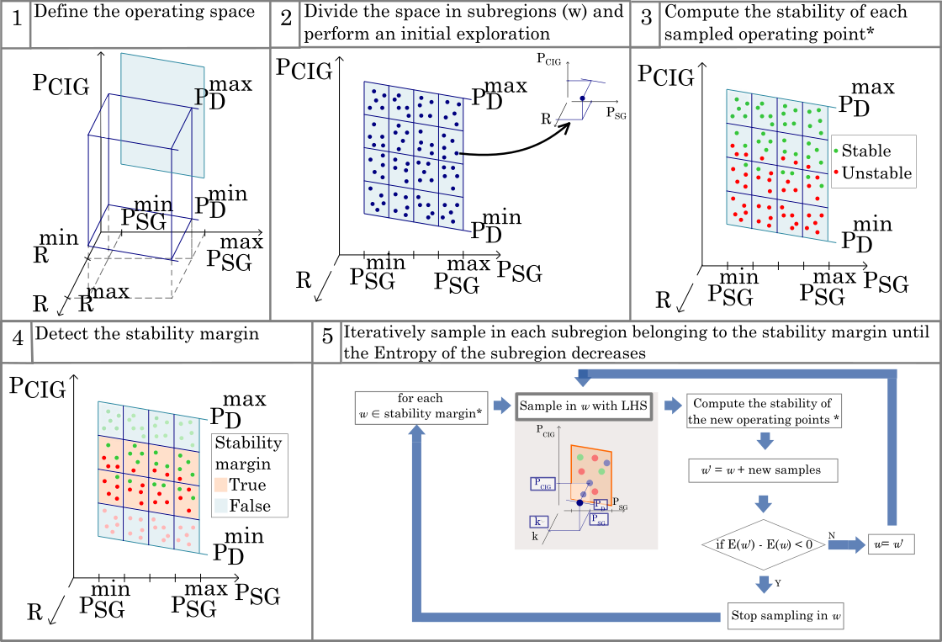
DATA GENERATION
* Parallelizable task

Slide 24
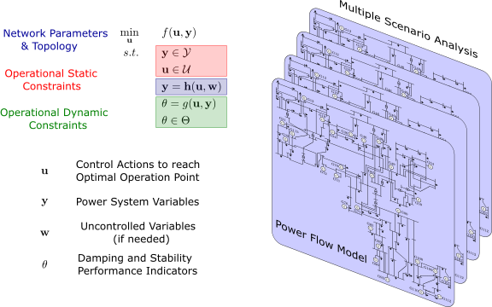
OPTIMAL POWER FLOW
Determine the set of control actions corresponding to the optimal operation point of the power system:
Information about power flow model and requirements are updated in real-time.
General formulation to maximize network resilience and performance.
Parallel computation of future scenarios based on forecast. Several time frameworks can be analyzed.

Slide 25




ACKNOWLEDGMENT
Questions?
Grant TED2021-130351B-C21 funded by MCIN/AEI/10.13039/501100011033 and, as appropriate, by “ERDF A way of making Europe”, by the “European Union” or by the “European Union NextGenerationEU/PRTR”.
Special thanks to:
UPC group: Eduardo Prieto-Araujo (coordinator), Francesca Rossi, Èlia Mateu, Juan Carlos Olives, Roger Margarit, Soufiane El Yaagoubi,
BSC group: Rosa Badia (coordinator), Francesc Lordan, Eduardo Iraola, Mauro Garcia

Slide 26
Experience with Hypersim on developing Digital Twins of modern power grids
Vinícius Albernaz Lacerda
Lecturer
CITCEA-UPC, Polytechnic University of Catalonia, Barcelona, Spain

